Slide 1
Software Metrics

Slide 2
Basic Terminologies
MEASURE: A quantitative indication of the extent, amount, dimension, or size of some attribute of a product or process (e.g. number of errors)
• METRICS: The degree to which a system, component, or process possesses a given attribute. It relates several measures (e.g. average number of errors found per person hour).
• INDICATORS: An indicator is a metric or combination of metrics that provide insight into the software process, a software project, or the product itself.
• DIRECT METRICS: Immediately measurable attributes (e.g. line of code, execution speed,defects reported).

Slide 3
INDIRECT METRICS: Aspects that are not immediately quantifiable (e.g. functionality, quantity, reliability).
• MEASUREMENT is the process by which numbers or symbols are assigned to the attributes of the entities in the real world in such a way as to define them accordingly to clearly defined rules.
• FAULTS:
Errors: Faults found by the developers during software development.
Defects: Faults found by the customers after release

Slide 4
WHY MEASURE SOFTWARE?
Establish baselines for comparisons with future assessments.
• To evaluate the status with respect to plans.
• Predict qualities of a product or a process by gaining understandings of relationships among process and products.
• Improve product quality and process performance by identifying roadblocks and inefficiencies.

Slide 5
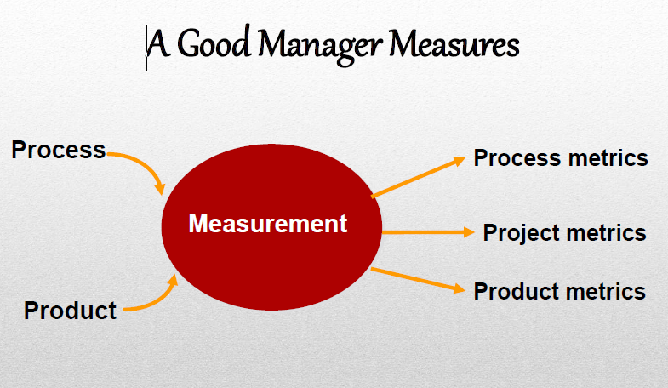

Slide 6
METRICS GUIDELINES
Use common sense and organizational sensitivity when interpreting metrics data.
• Provide regular feedback to the individuals and teams who collect measures and metrics.
• Don’t use metrics to appraise individuals.

Slide 7
Work with practitioners and teams to set clear goals and metrics that will be used to achieve them.
Never use metrics to threaten individuals or teams.
Metrics data that indicate a problem area should not be considered “negative.” These data are merely an indicator for process improvement.
Don’t obsess on a single metric to the exclusion of other important metrics.

Slide 8
Product metrics
Product metrics help the software engineers gain insight into the design and construction of the software they build by focusing on specific and measurable attributes of the work products.
These metrics examine the requirements model with the intent of predicting the size and complexity of the resulting system.

Slide 9
Function-oriented metrics
The Function point (FP) metric can be used effectively as a means for measuring the functionality delivered by a system.
• The FP metric can be used to -
a. Estimate the cost or effort required to design, code and test the software.
b. Predict the number of errors that will be encountered during testing
c. Forecast the number of components in the system

Slide 10
COMPUTING FUNCTIONAL POINTS
Function points are derived using an empirical relationship based on countable (direct) measures of software's information domain and assessments of software complexity.
Information domain values are defined in the following manner:
Number of external inputs (EIs)
Number of external outputs (EOs)
Number of external inquiries (EQs)
Number of internal logical files (ILFs)
Number of external interface files (EIFs)

Slide 11
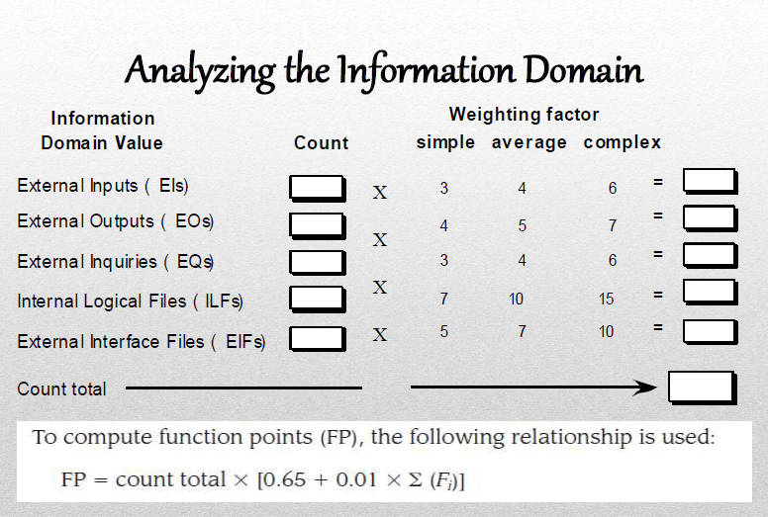

Slide 12
The Fi ( i=1 to 14) are value adjustment factors (VAF) based on responses to the following questions.
1.Will the application use data communications?
2.Are data or functions distributed?
3.Are there specific performance objectives that must be met?
4.Will the application run on a heavily used configuration requiring special design considerations?
5.Will the transaction rate of the application be high?
6. Will there be on-line data entry?
7. Will the application be designed for end-user efficiency?

Slide 13
8.Will there be on-line updates?
9.Is complex processing logic involved?
10.Is there an intent to provide usability for other applications?
11.How important are installation ease and conversion?
12.How important is operational ease?
13.Will the application be accessed from multiple sites?
14.Is there an intent with the design to facilitate change?

Slide 14
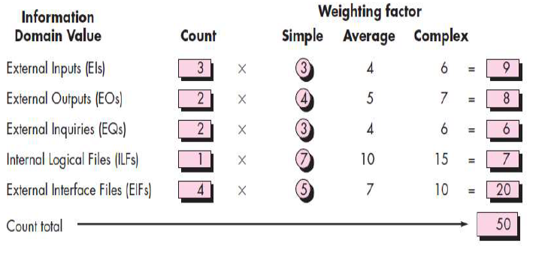
We assume that Σ(Fi) is 38 (a moderately complex product).
Therefore,
FP = count total X [0.65 +(0.01 X Σ(Fi) )]
50 X [0.65 + (0.01 X 38)] = 51.5

Slide 15
SIZE-ORIENTED METRICS
Size oriented metrics are derived by normalizing quality or productivity measures by considering the size of the software that has been produced.
A simple set of size-oriented metrics can be developed for each project :
Errors per KLOC
Defects per KLOC
Cost per KLOC
Pages of documentation per KLOC

Slide 16
PROCESS METRICS
Process metrics are used for strategic purposes.
Process metrics are collected across all projects and over long period of time. Their intent is to provide a set of process indicators that lead to long-term software process improvement.
The only way to improve any process is to measure specific attributes of the process, develop a set of meaningful metrics based on the outcomes and then use the metrics to provide indicators that will lead to strategic improvements.

Slide 17
PROCESS METRICS contd…
Quality-related
  focus on quality of work products and deliverables
Productivity-related
  Production of work-products related to effort expended
Statistical SQA data
  error categorization & analysis
Defect removal efficiency
  propagation of errors from process activity to activity
Reuse data
  The number of components produced and their degree of reusability

Slide 18
PROJECT METRICS
used to minimize the development schedule by making the adjustments necessary to avoid delays and mitigate potential problems and risks
used to assess product quality on an ongoing basis and, when necessary, modify the technical approach to improve quality.
every project should measure:
  inputs—measures of the resources (e.g., people, tools) required to do the work.
  outputs—measures of the deliverables or work products created during the software engineering process.
  results—measures that indicate the effectiveness of the deliverables.

Slide 19
Typical Project Metrics
Effort/time per software engineering task
Errors uncovered per review hour
Scheduled vs. actual milestone dates
Changes (number) and their characteristics
Distribution of effort on software engineering tasks

Slide 20
Measuring Quality
Maintainability—It is the ease with which a program can be corrected if an error is encountered, adapted if it’s environment changes or enhanced if the customer desires a change in the requirements.
Integrity— This is the measure of the system’s ability to withstand attacks to it’s security.

Slide 21
Correctness — The degree to which a program operates correctly according to specification. A program must operate correctly or it provides no value to it’s users. The most common measure for correctness is the defects per KLOC.
Usability—the degree to which a program is easy to use

Slide 22
Metrics for Small Organizations
time (hours or days) elapsed from the time a request is made until evaluation is complete, t_{queue}.
effort (person-hours) to perform the evaluation, W_{eval}.
time (hours or days) elapsed from completion of evaluation to assignment of change order to personnel, t_{eval}.
effort (person-hours) required to make the change, W_{change}.
time required (hours or days) to make the change, t_{change}.
errors uncovered during work to make change, E_{change}.
defects uncovered after change is released to the customer base, D_{change}.

